Slide 1

Parabola Applied
RCET 0264 Introductory Calculus
Tim Leishman

Slide 2
Parabola
The surface of a roadway over a bridge follows a parabolic curve with vertex at the middle of the bridge. The span of the bridge is 400m. The roadway is 16m higher in the middle than at the ends. How far above the end supports (ground) is a point 50m from the middle? & 150m from the middle?

Slide 3
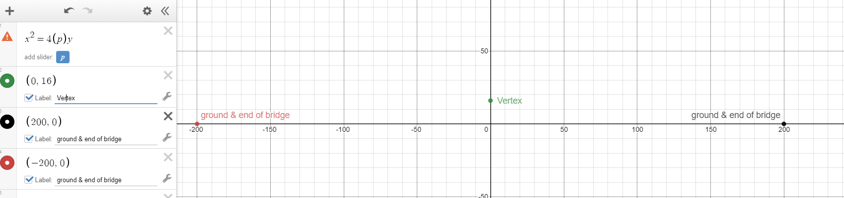
Parabola
The surface of a roadway over a bridge follows a parabolic curve with vertex at the middle of the bridge. The span of the bridge is 400m. The roadway is 16m higher in the middle than at the ends. How far above the end supports (ground) is a point 50m form the middle? & 150m from the middle?

Slide 4
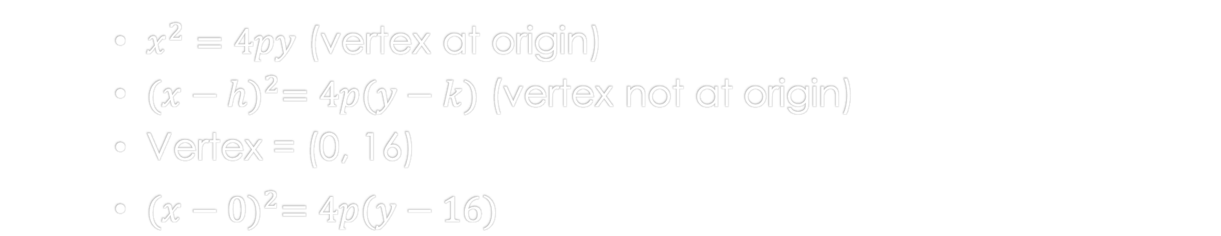
Parabola
The surface of a roadway over a bridge follows a parabolic curve with vertex at the middle of the bridge. The span of the bridge is 400m. The roadway is 16m higher in the middle than at the ends. How far above the end supports (ground) is a point 50m form the middle? & 150m from the middle?
$x^{2}=4py$ (vertex at origin)
${(x−h)}^{2}=4p(y−k)$ (vertex not at origin)
Vertex = (0, 16)
${(x−0)}^{2}=4p(y−16)$

Slide 5
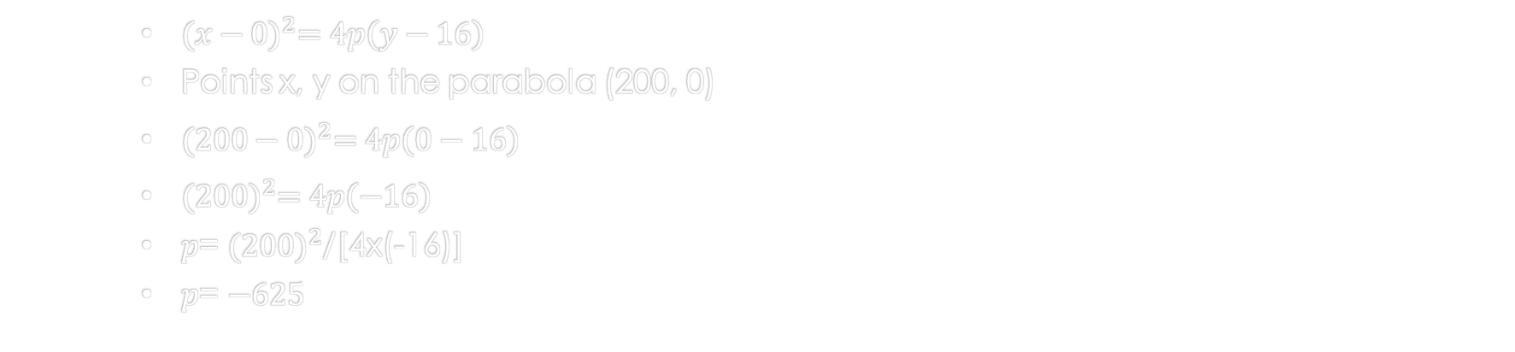
Parabola
The surface of a roadway over a bridge follows a parabolic curve with vertex at the middle of the bridge. The span of the bridge is 400m. The roadway is 16m higher in the middle than at the ends. How far above the end supports (ground) is a point 50m form the middle? & 150m from the middle?
${(x−0)}^{2}=4p\left(y−16\right)$
Points x, y on the parabola (200, 0)
${(200−0)}^{2}=4p\left(0−16\right)$
${(200)}^{2}=4p\left(−16\right)$
$p$= ${(200)}^{2}$/[4x(-16)]
$p$= $−625$

Slide 6
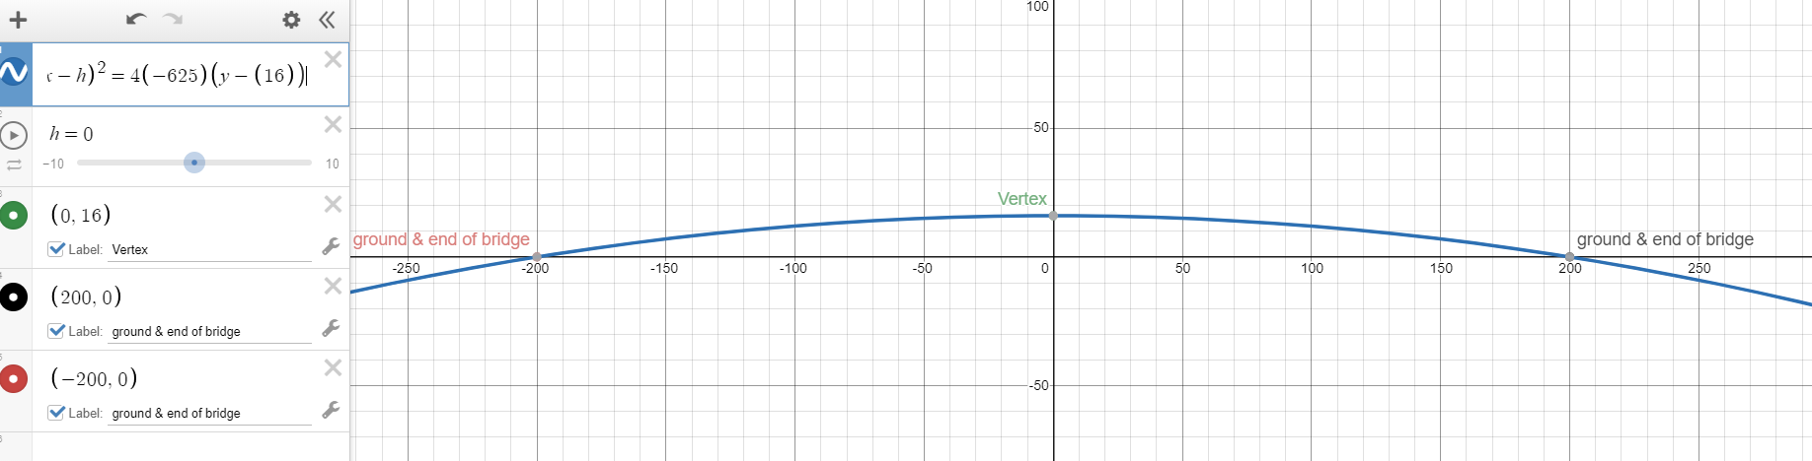

Parabola
The surface of a roadway over a bridge follows a parabolic curve with vertex at the middle of the bridge. The span of the bridge is 400m. The roadway is 16m higher in the middle than at the ends. How far above the end supports (ground) is a point 50m form the middle? & 150m from the middle?
$p$= $−625$
${(x−0)}^{2}=4(−625)\left(y−16\right)$

Slide 7
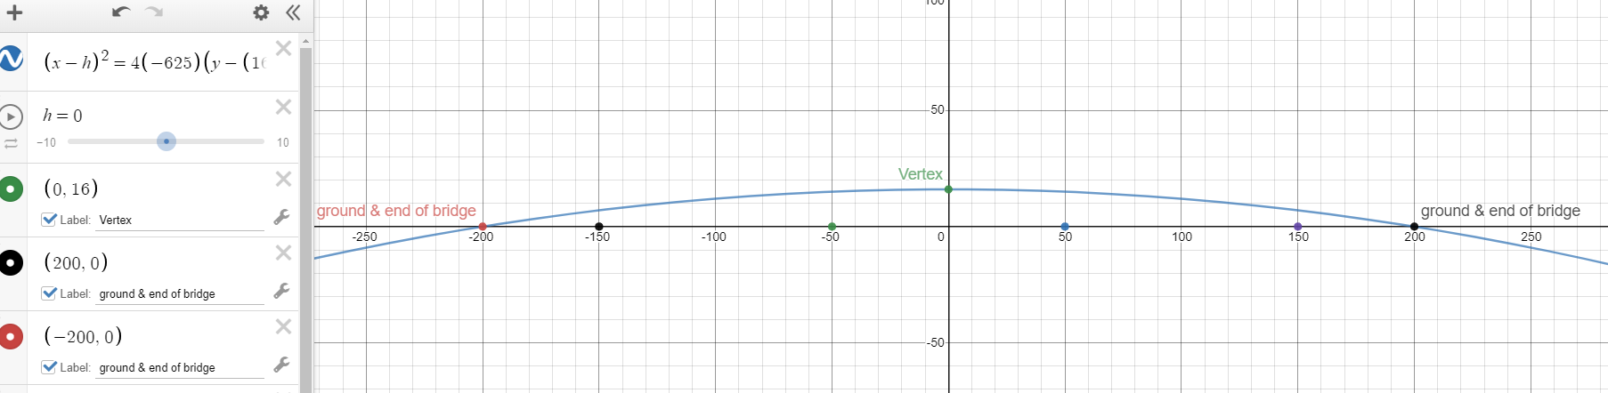

Parabola
The surface of a roadway over a bridge follows a parabolic curve with vertex at the middle of the bridge. The span of the bridge is 400m. The roadway is 16m higher in the middle than at the ends. How far above the end supports (ground) is a point 50m form the middle? & 150m from the middle?
${(x−0)}^{2}=4(−625)\left(y−16\right)$
Supports at 50m & 150m?

Slide 8
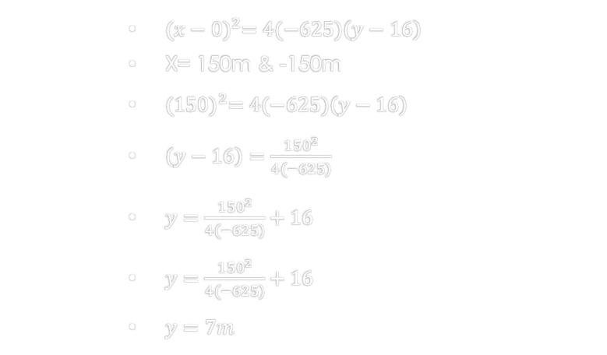
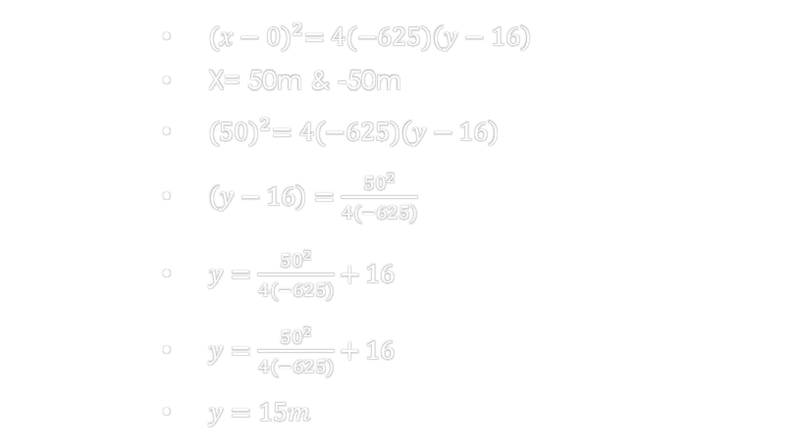
Parabola
${(x−0)}^{2}=4(−625)\left(y−16\right)$
X= 50m & -50m
${(50)}^{2}=4(−625)\left(y−16\right)$
$\left(y−16\right)=\frac{{50}^{2}}{4(−625)}$
$y=\frac{{50}^{2}}{4(−625)}+16$
$y=\frac{{50}^{2}}{4(−625)}+16$
$y=15m$
${(x−0)}^{2}=4(−625)\left(y−16\right)$
X= 150m & -150m
${(150)}^{2}=4(−625)\left(y−16\right)$
$\left(y−16\right)=\frac{{150}^{2}}{4(−625)}$
$y=\frac{1{50}^{2}}{4(−625)}+16$
$y=\frac{{150}^{2}}{4(−625)}+16$
$y=7m$

Slide 9
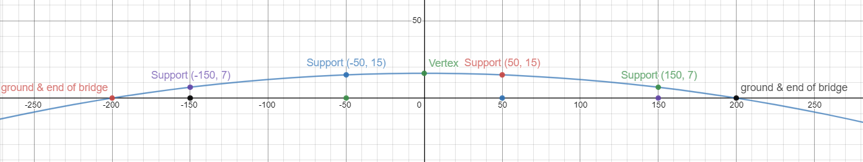
Parabola
${(x−0)}^{2}=4(−625)\left(y−16\right)$
X= 50m & -50m
${(50)}^{2}=4(−625)\left(y−16\right)$
$\left(y−16\right)=\frac{{50}^{2}}{4(−625)}$
$y=\frac{{50}^{2}}{4(−625)}+16$
$y=\frac{{50}^{2}}{4(−625)}+16$
$y=15m$
${(x−0)}^{2}=4(−625)\left(y−16\right)$
X= 150m & -150m
${(150)}^{2}=4(−625)\left(y−16\right)$
$\left(y−16\right)=\frac{{150}^{2}}{4(−625)}$
$y=\frac{1{50}^{2}}{4(−625)}+16$
$y=\frac{{150}^{2}}{4(−625)}+16$
$y=7m$

Slide 10
Parabola
References:
Ewen, D., Gary, J. S., & Trefzger, J. E. (2005). Technical calculus. Upper Saddle River, NJ: Pearson/Prentice Hall.
https://www.desmos.com/calculator/zs5wfg9uem

